Slide 1


Travel Portal

Slide 2

Agenda
1.System functionality.
2.Application architecture.
3.Database overview.
4.Server side overview.
5.Client side overview.

Slide 3
System functionality
Взаимодействие с картами Google;
Создание и работа с метками на карте;
Авторизация через соц-сети Google+ и Facebook;
Привилегии юзеров
Some FR

Slide 4
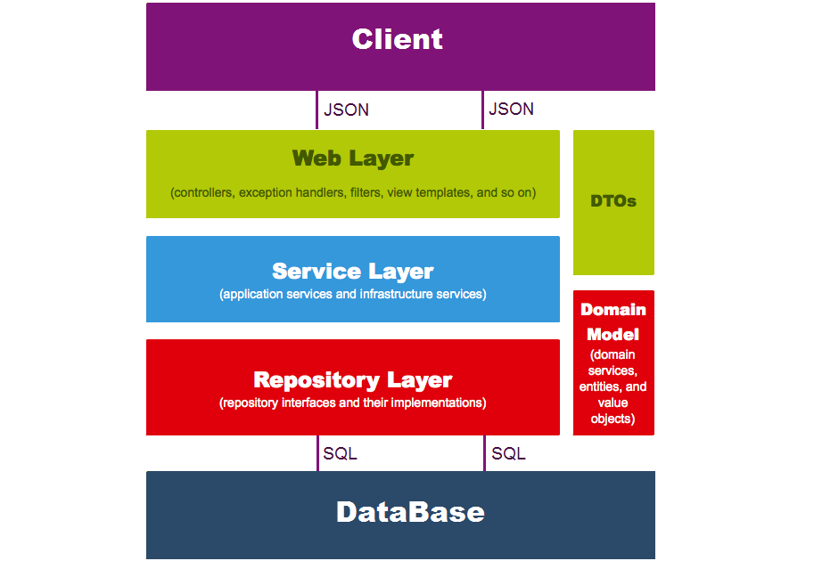
Simple application architecture model

Slide 5
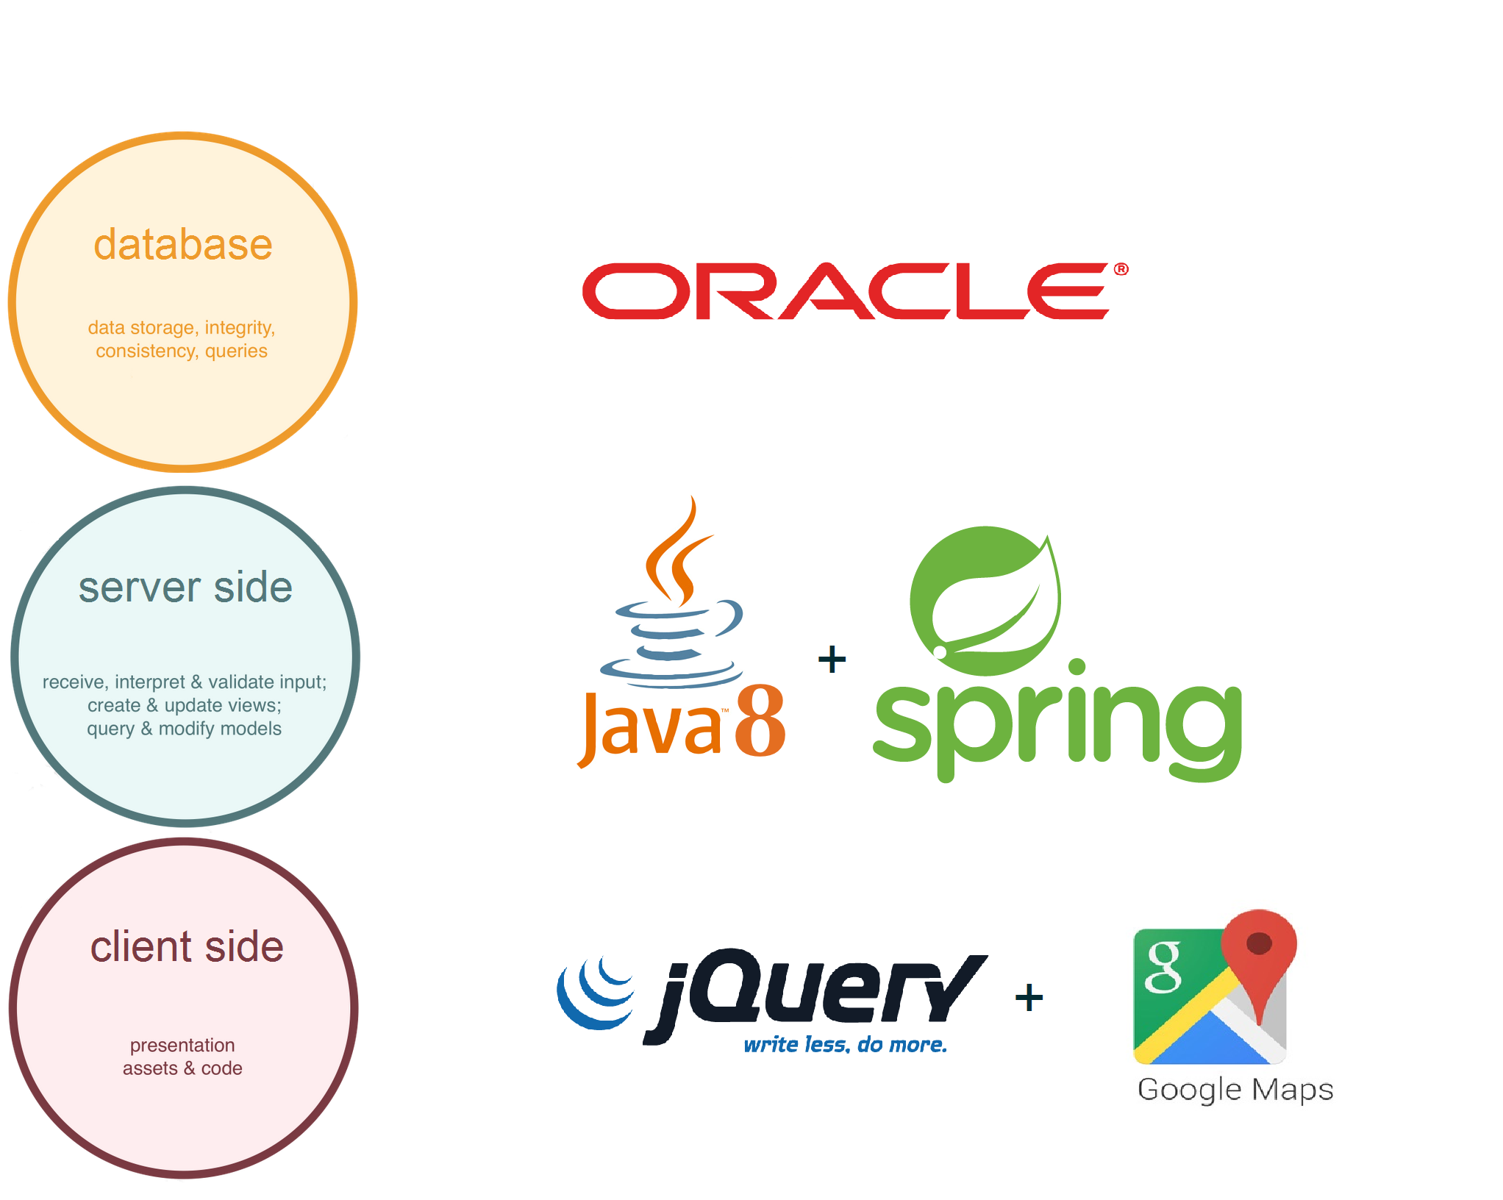
Used technologies

Slide 6
Database overview

Slide 7
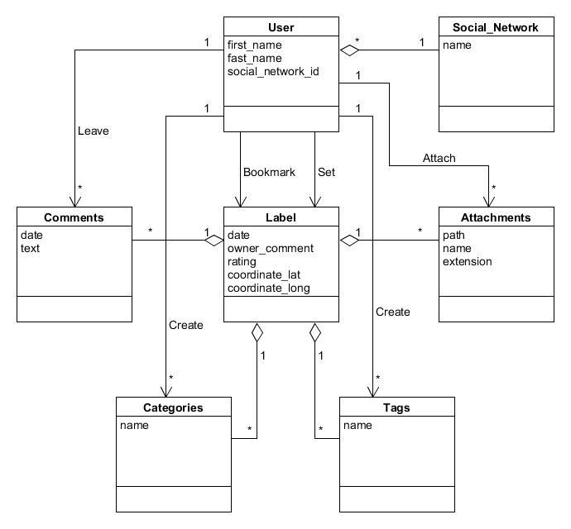
Object model

Slide 8
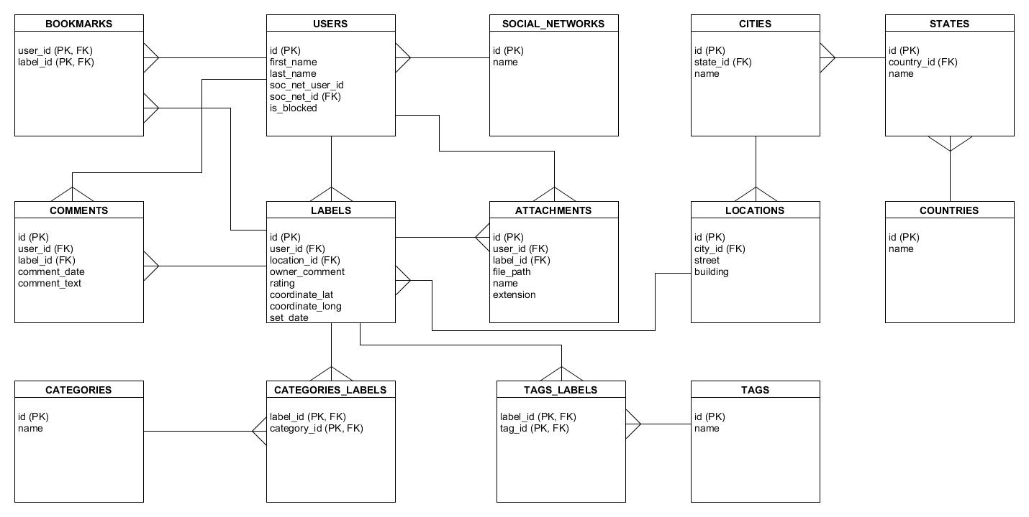
Relational model

Slide 9
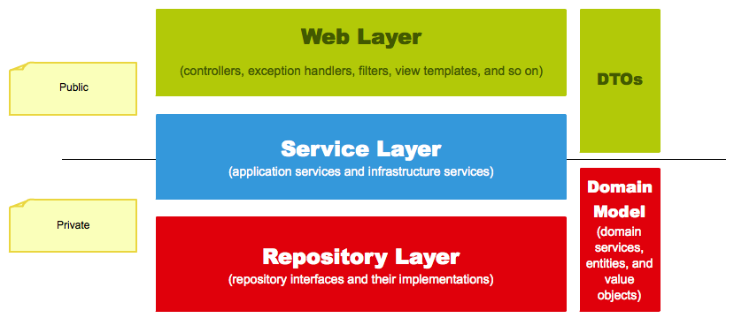
Server side overview

Slide 10

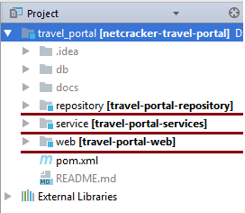
Each Maven module represent its own layer.

Slide 11
Repository layer

Slide 12
Service layer

Slide 13
Web layer

Slide 14
Client side overview

